Slide 1
Learning to Love Again
Revelation 2:1-7
Lewis Winkler
Crossroads International Church BibleStudyDownloads.org

Slide 2
Revelation
The Seven Churches of Revelation
Learning to Love Again

Slide 3
Introduction:
What is true love?
What comes to your mind when you hear the phrase, “first love”?
What happens when our first loves dies?
How can we learn to love again?

Slide 4
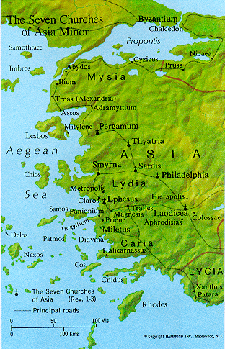
Opening Explanation (1):
To the Church at Ephesus

Slide 5
Ephesus:
At that time it was the most important city in western Asia Minor (modern-day Turkey).

Slide 6
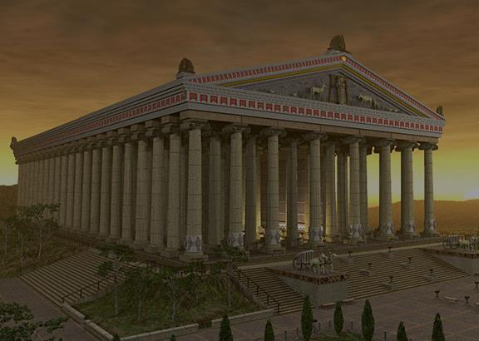
Ephesus:
It was home to the Magnificent Temple of Artemis (Diana).

Slide 7
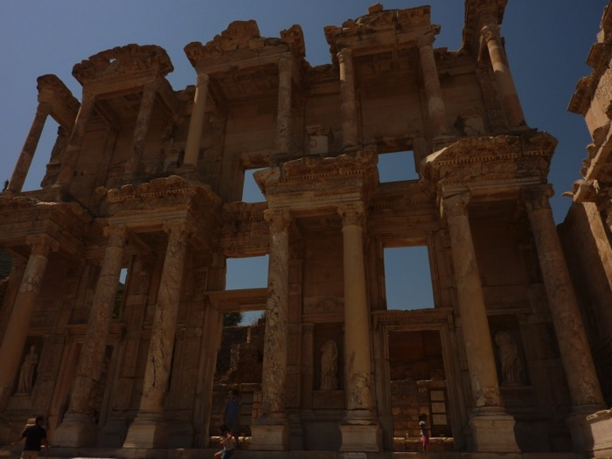
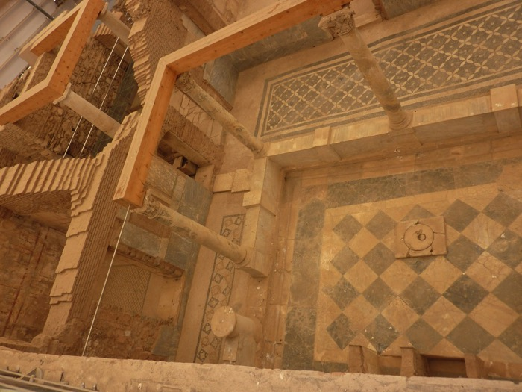
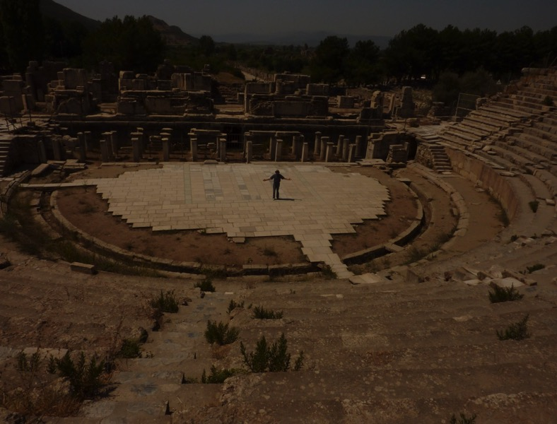
Ephesus Today:

Slide 8
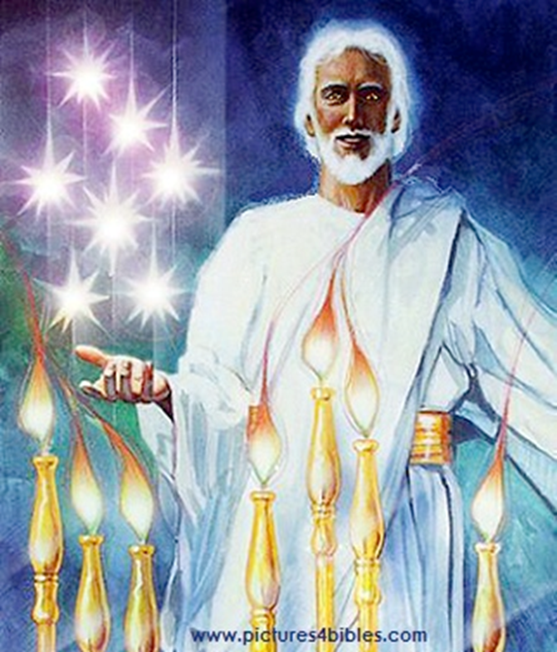
Opening Explanation (1):
To the “angel” of the Church in Ephesus

Slide 9
Three Likely Possibilities:
They are spiritual beings (“angels”) that watch over each of the churches.
They are references to the pastoral leader of each of the churches.
They represent the prevailing spirit of each individual church.

Slide 10
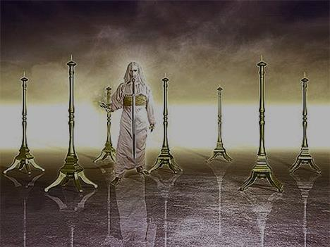
Opening Explanation (1):
From Jesus Who Cares for and Walks with the Church

Slide 11
Encouraging Commendation (2-3, 6):
I know your deeds.

Slide 12
Encouraging Commendation (2-3, 6):
Your Hard work (2)
Your Intolerance of Wicked People (2)
Your Testing of and Refusal to Accept People Claiming (But Failing) to Be Apostles (2)
Your Energetic Endurance through Hardship for Jesus’ Sake (3)
Your Hatred of Nicolaitan Practices (6)

Slide 13
Some Food for Thought:
How would Jesus encourage and commend Crossroads International Church?
How would Jesus encourage and commend you personally?

Slide 14
Cautionary Exhortation (4-5):
You have forsaken your first love.
“They had yielded to the temptation, ever present to Christians, to put all their emphasis on sound teaching. In the process, they lost love, without which all else is nothing.”
—Leon Morris

Slide 15
Cautionary Exhortation (4-5):
How do we learn to love again?
Remember!
Repent!
Redo!

Slide 16
Learning to Love Again:
Remember!
But what?

Slide 17
Learning to Love Again:
Repent!
But of what?

Slide 18
Learning to Love Again:
Redo!
But what?

Slide 19
The First Love of the Ephesians (Acts 19:8-20):
They held the name of Christ “in high honor” (verse 17).
They “openly confessed their evil deeds” (verse 18).
Those who had previously practiced sorcery “brought their scrolls together and burned them publicly” (verse 19).

Slide 20
The First Love of the Ephesians (Acts 19:8-20):
As a result, “the word of the Lord spread widely and grew in power” (verse 20).

Slide 21
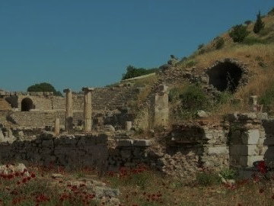
Cautionary Exhortation (4-5):
If you refuse to do these things, I (Jesus) will remove you as a church.

Slide 22
Some Food for Thought:
How would Jesus warn Crossroads International Church?
What do we need to remember?
What do we need to repent of?
What do we need to start doing (again)?
How can we truly make Jesus our first love?

Slide 23
Closing Motivation (7):
If you are spiritually sensitive, then listen!
The overcomers of evil will eat from the tree of life in God’s eternal kingdom (heaven)!

Slide 24
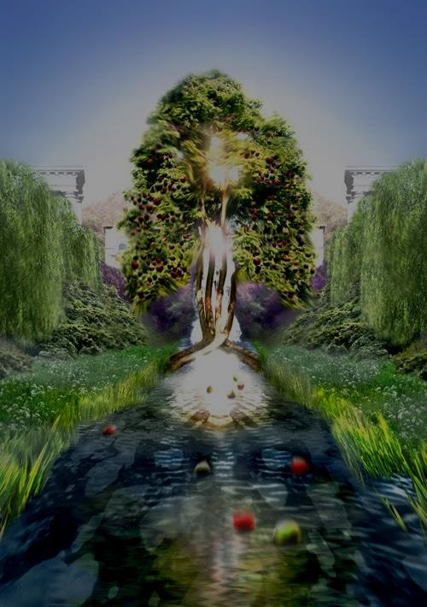
Closing Motivation (7):
“Then the angel showed me the river of the water of life, as clear as crystal, flowing from the throne of God and of the Lamb, down the middle of the great street of the city. On each side of the river stood the tree of life . . . . And the leaves of the tree are for the healing of the nations. No longer will there be any curse. . . . They will see [God’s] face and his name will be on their foreheads. . . . And they will reign forever and ever. . . . These words are trustworthy and true.”
—Revelation 22:1-6

Slide 25
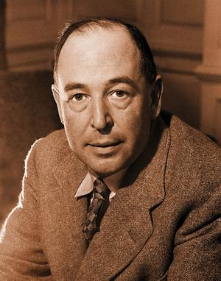
C. S. Lewis from “The Weight of Glory”
“If we consider the unblushing promises of reward and the staggering nature of the rewards promised, it would seem that our Lord finds our desires not too strong, but too weak. We are half-hearted creatures fooling about with drink and sex and ambition when infinite joy is offered us, like an ignorant child who wants to go on making mud pies in a slum because he cannot imagine what is meant by the offer of a holiday at the sea. We are far too easily pleased.”

Slide 26
Conclusion:
Jesus calls us to love Him first and foremost by:
REMEMBERING
REPENTING
REDOING

Slide 27
Main Idea:
In order to restore our first love, we must remember, repent, and redo.

Slide 28
Personal Application:
What do I need to remember?
What do I need to repent of?
What do I need to do again—or perhaps begin to do for the very first time—to really love Jesus as my first and foremost love?

Slide 29
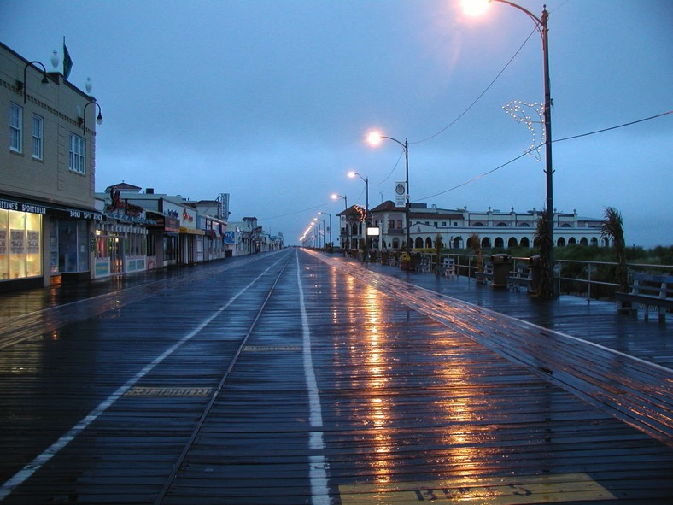
A Story of First Love:
Ocean City, New Jersey, 1986

Slide 30
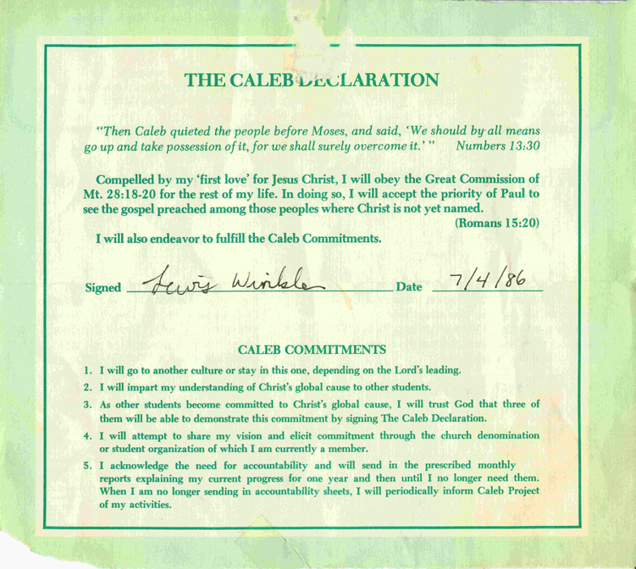
A Story of First Love:
The Caleb Declaration:

Slide 31
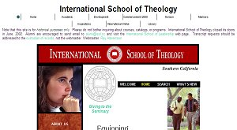
A Story of First Love:
International School of Theology, 1993

Slide 32
A Story of First Love:
But somewhere along the way . . . .
I gradually, almost imperceptibly, became comfortable, complacent, and content in my walk with God, even though I was still in full-time ministry.

Slide 33
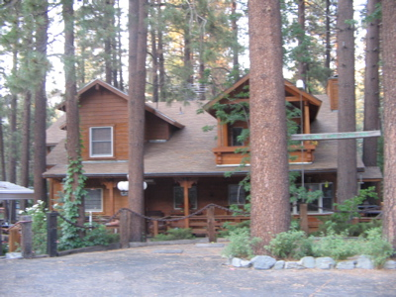
A Story of First Love:
Then, in the winter of 2002 at a cabin in the southern California mountains . . .

Slide 34
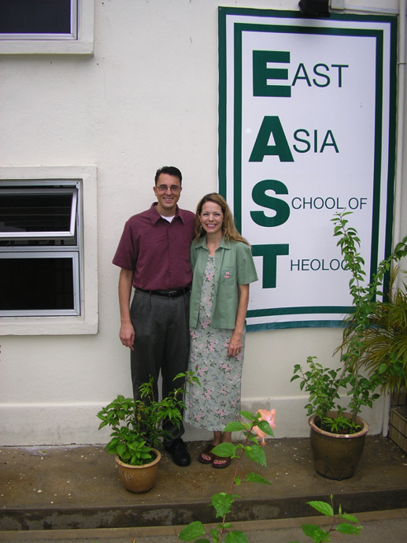
A Story of First Love:
Singapore and the East Asia School of Theology in August 2006

Slide 35
A Story of First Love:
Crossroads International Church, November 2006

Slide 36
The Ongoing Challenge:
Do you love Jesus above all other loves?
If you have let other people, pursuits, and things crowd out your love for Him, are you willing to learn to love Him as your first love again?

Slide 37
Black

Slide 38
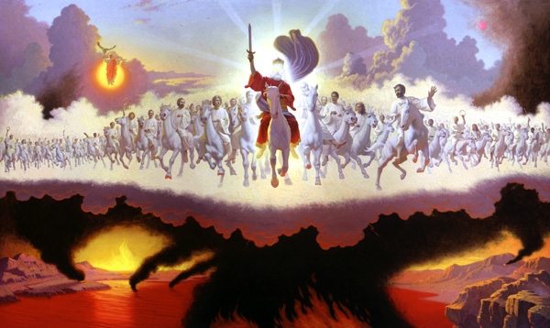
Jesus Wins!
Series on Revelation

Slide 39
NT Sermons link at biblestudydownloads.com
Get this presentation for free!

